Slide 1
Law for Life: the Foundation for Public Legal Education
Mary Marvel

Slide 2
About Law for Life
Law for Life: the Foundation for Public Legal Education is a charity dedicated to ensuring everyone has the knowledge, skills and confidence that they need to secure access to justice.

Slide 3
About Law for Life
What we do:
We run the award winning Advicenow website
We deliver community-based training and other educational programmes
Research and policy

Slide 4
Advicenow
Our own Advicenow guides, tools, and films
aimed primarily at people who either can’t access much help with their legal problem or don’t know what help to access.
Information service gathers and quality checks the best information available on the web from a wide-range of organisations
Help Directory

Slide 5
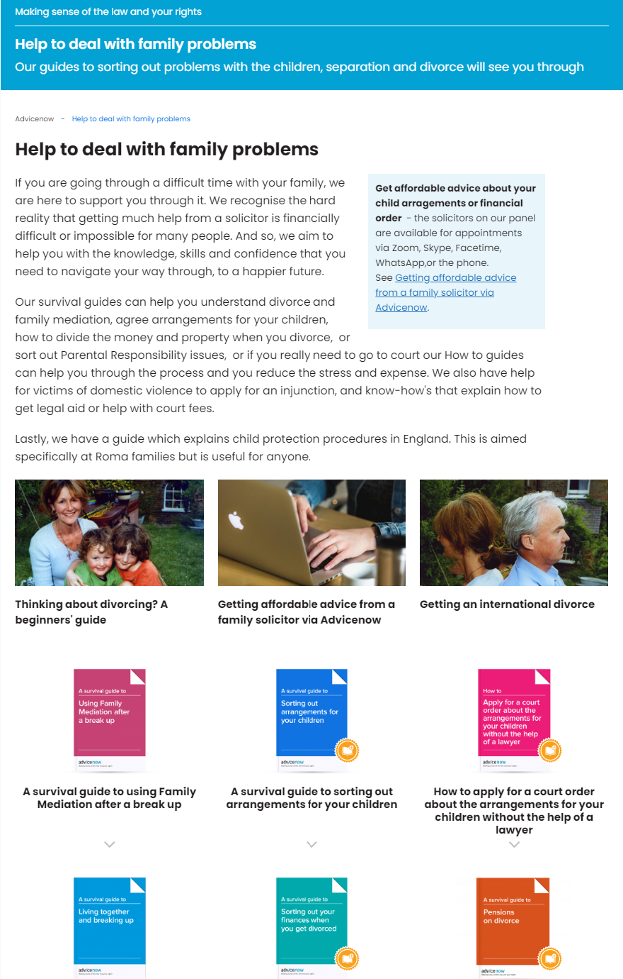
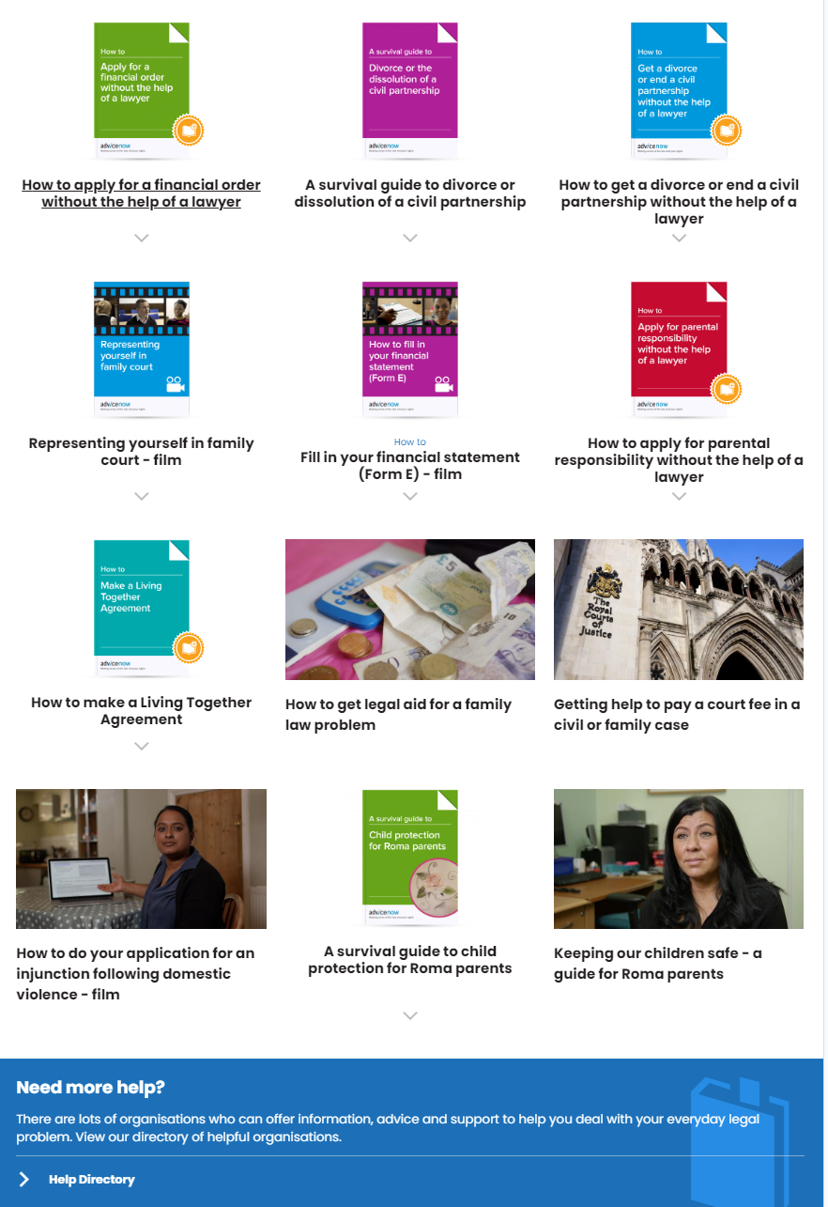

Slide 6
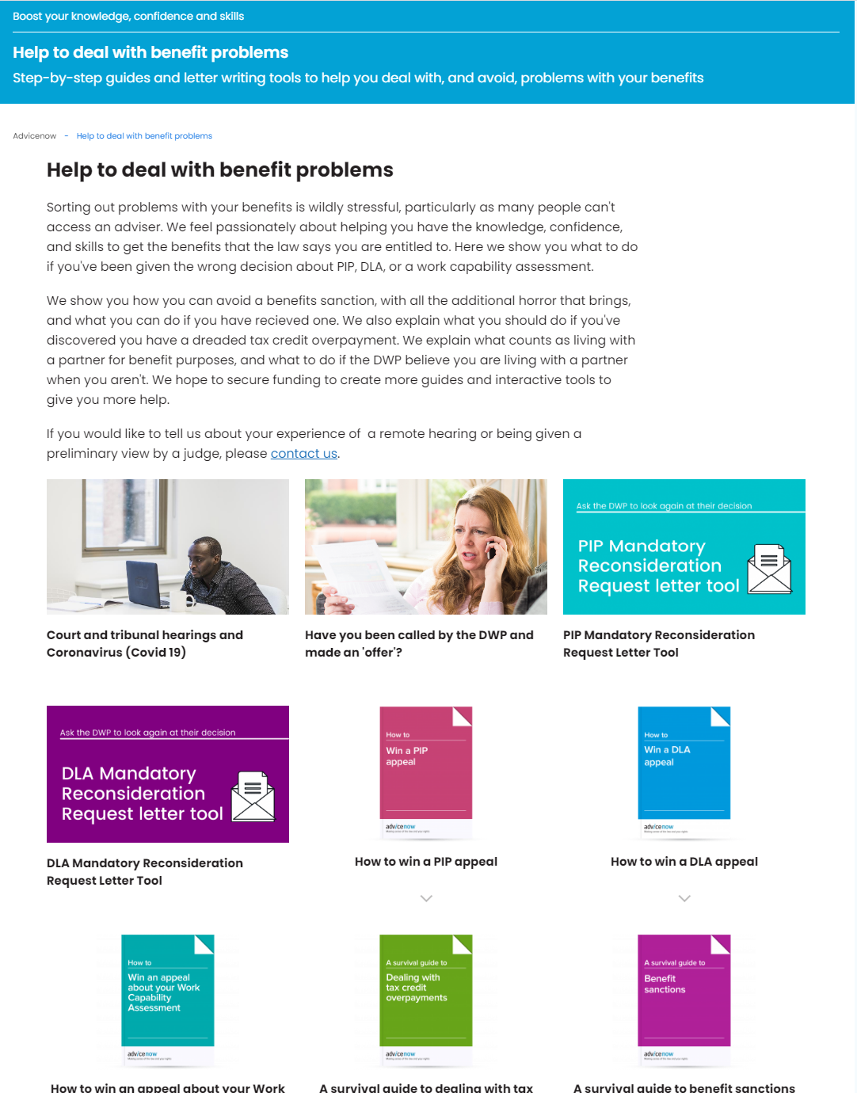
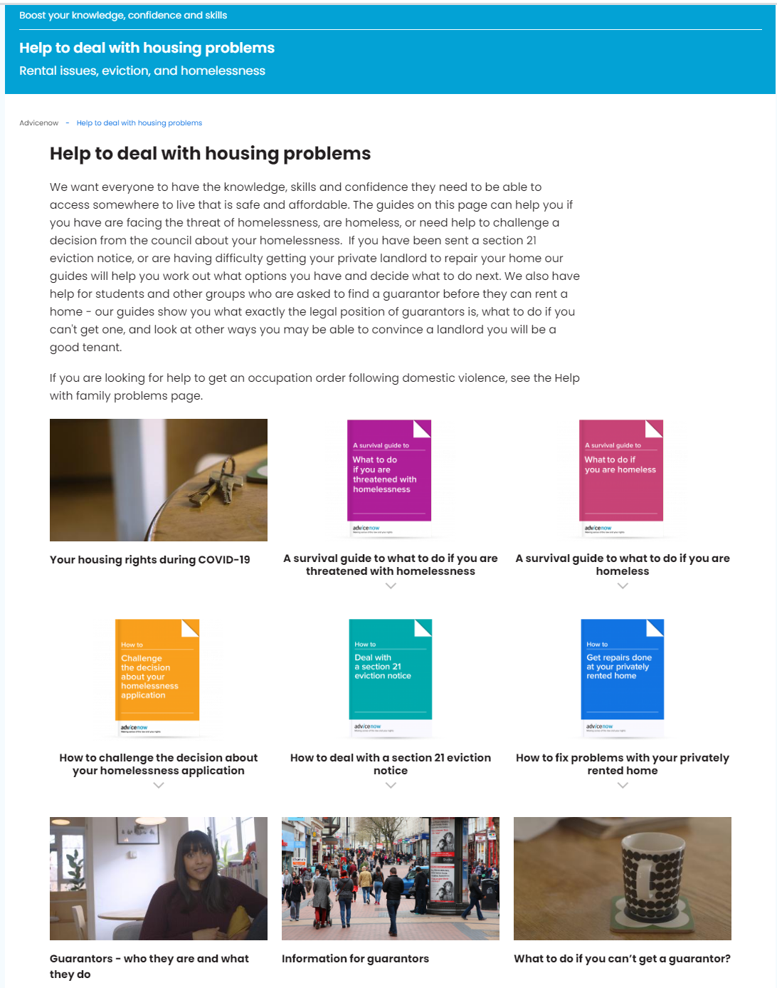
Advicenow
There for people looking online for help.
Information service – what we call Top Picks - gathers and quality checks the best information available on the web from a wide-range of organisations
Help Directory

Slide 7
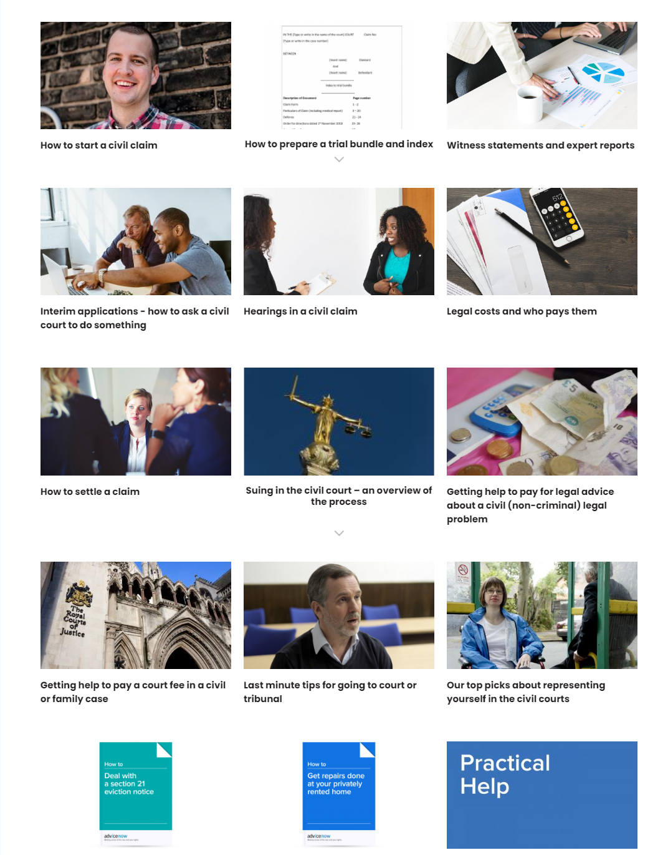
Advicenow

Slide 8
Advicenow
There for people looking online for help.
Signposted to from advice services, community groups, law centres, legal clinics

Slide 9
Only
11%
of legal problems are correctly identified as legal problems

Slide 10
Attempting to deal with a legal problem requires
knowledge that it is a legal problem,
confidence, and
skills

Slide 11
Legal problems
low income
age (being young or older)
reduced educational qualifications
ill-health.
manual workers
migrants

Slide 12
Public legal education training
Individuals and intermediaries
via community groups and grassroots organisations
Women’s groups, renters groups, youth and student programmes, groups supporting refugees and migrants, disabled people, victims of domestic violence and trafficked women, sex worker collectives, and
NHS social prescribing link workers

Slide 13
Our training helps people to
understand how the law works and to
build their skills and confidence to use it and to
know what the first steps to take are, and to
use the resources on Advicenow
“I am armed with the knowledge and skills, and developed the confidence to inform clients in despair, and guide them to find alternatives.”
Course participant

Slide 14
Affordable Advice Pathway
Clear costs upfront
Confident about what they will get advice on in return
More affordable by design
An easy process

Slide 15
Thank you!
twitter.com/LfL_Advicenow
facebook.com/advicenowlfl
www.lawforlife.org.uk
www.advicenow.org.uk
Mary.Marvel@lawforlife.org.uk
Notes:
And that’s the end from me .
Follow us on twitter or facebook.
Our facebook account is more aimed at end users.
And please do spread the word to your service users and colleagues.

