Slide 1
Sharing lessons from project development
Refining the Legal Advocacy Support Project (LASP)

Slide 2
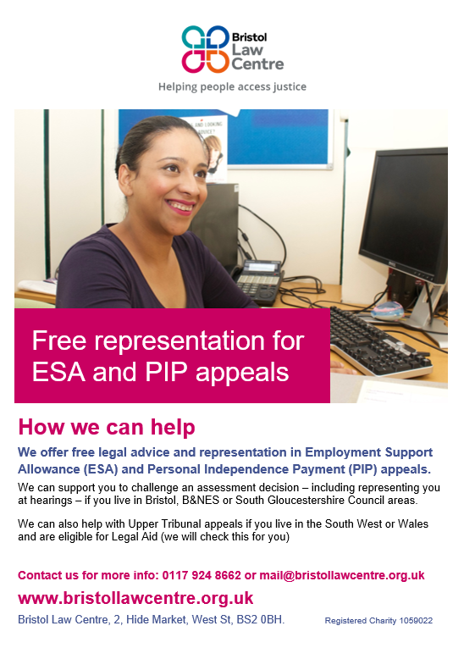
Legal Advocacy Support Project (LASP)
Response to LASPO cuts to welfare benefits legal aid
Partnership between Bristol Law Centre and four local universities
Trains law students to prepare and represent appellants at First-tier Tribunal
High success rate
Notes:
(approx. 98% cases taken out of scope)
UWE, UoB, BPP, and Ulaw
to represent appellants in the for PIP & ESA hearings

Slide 3
The First-tier Tribunal (Social Security and Child Support Appeals)
Tribunal panel in an entitlement appeal:
Judge
Medically Qualified Member – usually a doctor
Disability Qualified Member (only in PIP hearings)
Department for Work and Pensions (DWP) can send a representative
Tribunal can (often does) overturn and remake decision
Notes:
In Bristol usually sits in Magistrates Court or Civil Justice Centre
(But often doesn’t)
on appellant’s limited capability for work (ESA) or level of disability (PIP)

Slide 4
What LASP does
What appeals do we represent?
Employment & Support Allowance (ESA)
Personal Independence Payment (PIP)
What do we submit to the Tribunal?
Legal submission
Appellant’s statement
Further medical evidence
Timescales
Over 34 weeks from appeal lodged to case listed
Dependent on HMCTS – can request urgent listing but unlikely
Notes:
ESA primarily for people too sick or disabled to work
PIP used to be DLA – for disability affecting daily life/mobility
We try to keep submissions as short as possible, but to anticipate anything the tribunal may ask for – prevent postponement
GDPR been good for us – no longer have to pay for medical records, though we do suggest appellants who need medical reports
(can be over a year since decision made)

Slide 5
How LASP does it
All Casework supervised by experienced caseworkers
Track cases on Case Management System (CMS) – we use AdvicePro
Volunteers work on client files only from Law Centre, data protection means not sensible to manage remote working
Notes:
Regulated by SRA / Lexel standard of work

Slide 6
Developing the project over the last 6 years
Continual process of ‘tinkering’ with how project runs
Major recent review and redesign focussed on modelling client journey and dividing volunteer responsibilities into specialist roles
Lessons learned in earlier years have made possible the design of a systematic referral / triage / allocation process
Notes:
this works as we have an approx. 9-12 month turnover of volunteers which means improvements can be embedded in new generations relatively easily
which has meant we can take on more referrals as can track urgency and predict listing

Slide 7
The LASP review
OVERRIDING OBJECTIVE:
To provide high quality appeals casework and advocacy to as many disabled appellants as possible.
CHANGE OBJECTIVES
Casework time should be linked more closely to case complexity / likely outcomes; and
Recruit, deploy, and retain volunteers more effectively to increase scale & efficiency of work.
Notes:
Main change was to the remit of volunteer roles – greater specialisation has meant greater capacity and an increased caseload
Creation of Legal Practice Volunteer role – focused on pre-hearing work and trained on our Case Management System – has meant that Welfare Benefits Casework Assistant (paid role) has been able to manage a larger caseload than previously

Slide 8
Old Volunteer roles
New Volunteer roles
ESA Volunteers
PIP Volunteers
Upper Tribunal Volunteers
Advocacy Volunteers – PIP
Advocacy Volunteers – ESA
Legal Practice Volunteers
Casework Supervisor Volunteers – PIP
Casework Supervisor Volunteers – ESA
Communication Volunteers
Upper Tribunal Volunteers

Slide 9
Tools
Templates
CCLs
Evidence notes
Requests for medical evidence
Submissions
Spreadsheets
Papers in
Volunteer attendance
Hearings listed
and…

Slide 10
the flowchart
Papers arrive – added to s/s
CCL drafted
Case opened on CMS
Caseworker triage
No merit
Simple Case
Complex case
Papers returned
Evidence note drafted
Submission prepared once case listed
Case fully prepared
Client / doctor chased for further evidence
Representation
Representation
Casework Assistant
Caseworkers / Experienced Volunteers
Legal Practice Volunteers
Advocacy Volunteers
Notes:
v. Basic version of our process flowchart

Slide 11
the shelf
Spare authority forms
Blank ESA files
Blank PIP files
Blank UT files
Papers
in
Waiting for authority form
Needs Evidence note
CCL
to do
To close
Notes:
Example of non-digital technology

Slide 12
Managing the volunteer relationship - practical advice
The work will take longer at first than if you did it yourself
Spreadsheets – think about what you want them to do, learn how to do that, ignore the rest
Make sure you bcc when emailing a group of volunteers (unless you have all of their permission to share personal emails with each other)
Build in time to step back and review role development, easy to get stuck in trenches – volunteers are vulnerable to burnout too
Don’t accidentally employ your volunteers
Notes:
At multiple points we have tried to use volunteers to communicate with other volunteers – managing contact including session times, attendance and logistics. It may be that other people can figure out how to make this work, but we’ve never managed to keep it going over an extended period of time. Hence importance of casework assistant role
Employing- don’t panic. Most caselaw (X v Mid Sussex CAB, Breakell v West Midlands Reserve Forces' and Cadets Association, Melhuish v Redbridge Citizens Advice Bureau) is favourable to voluntary organisations

Slide 13
Evidencing the value of a project
Client feedback is invaluable
So is volunteer feedback!
Don’t do anything for the sake of it (e.g. exit interviews).
Stats are great. Stories bring them to life.
Notes:
E.g. Success at FtT fairly high anyway, so what value do we add to appellants, esp. those with strong cases? Not just likelihood of success – bigger picture than that, and our feedback helps us evidence this
Know what question you’re asking and what form an answer might come in.

