Slide 1
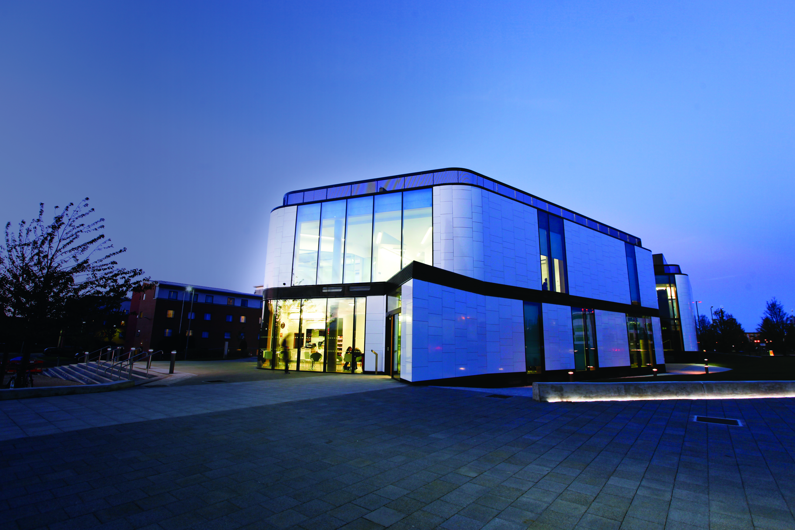
Hertfordshire Law Clinic
LGBT+ clinic
Diana Kirsch
Amanda Thurston
Notes:
Welcome & Introductions
Talking today about the practical experience we had in setting up our LGBT+ clinic – which eventually had a soft launch with social media and press releases at the end of April 2021 and reaction from press good – two radio interviews, but no clients !

Slide 2



Challenges:-
Partnership/Referrals
Insurance
Training resources
Supervisors
Logo
Notes:
We have periodically looked to expand the clinic every 6 months or so since we opened – to widen the areas of law, to provide more support for the local community and more interest for the students. We therefore first started planning in late 2020 with a view to launching the clinic at the end of LGBT+ History month (February). However, planning didn’t go as smoothly as we had hoped.
We didn’t want to just play lip service to having this new clinic – we ideally wanted to launch it in partnership with a local (Herts based) LGBT+ charity or support group. We tried contacting various organisations with few positive responses. County Council refused point blank to meet with us and no other organisations seemed to be based in the county.
We also needed to ensure we had appropriate specialist training – not so much in the legal areas, but in the awareness side. We wanted this to come from those experienced enough to make it sound like second nature. However, staff unconscious bias online course (which is brilliant) could not be used for students
And of course the usual fun and games of getting the insurers to day yes to anything ! Oh, and what logo to use – could we use another rainbow flag ?

Slide 3
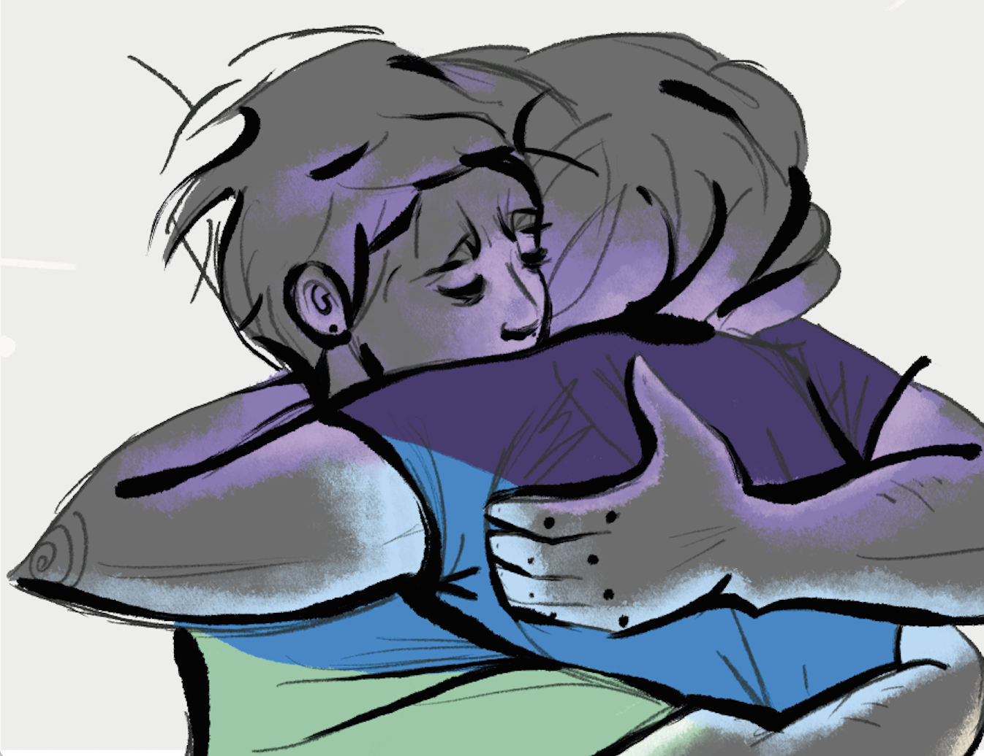
Solutions:-
  SU Society
  UH Staff Society
  Law Society Division
  TOKKO Youth Charity
  The Kite Trust
  CPS
  Essex & Queen Mary Universities
Notes:
So initial feelers out into the immediate local community were less than positive, but that is not to say we have not found support and a warm welcome for our idea.
UH has strong LGBT+ student and staff networks. They have been helpful and even took a part in our training, and helped us with our campaign to get everyone to add their preferred pronoun to their email footer. The SU also provided us with our logo – created by one of their committee members for LGBT History month
A personal contact in the Law Society’s Division was great – offering practical supervision support and the offer of talks.
Perhaps one of the biggest helps has come from Andy Calvert – CEO of TOKKO – a youth charity based in Luton. They have a project aimed at helping young people coming out as gay or trans. Andy helped with our training event, signposted us to other organisations like the Kite Trust (another charity supporting young adults) and was just very “down to earth” on pronoun use and apologizing when you get in wrong !
The CPS may be a bit of a red herring. The patron of our clinic is Grace Ononiwu – and she offered the assistance of her staff to run an LGBT+ Hate crime workshop for our students which was a great success.
And we did the usual LawWorks thing – which is to approach our peers – we asked other university law clinics how they had done it.

Slide 4

Legal Issues:-
Discrimination – work, housing
Change of name
Health Care Advocacy
Gender Recognition Certificate
Notes:
What we recognized early on is that the areas of law the LGBT+ community want advice on are not necessarily new or different – they get divorced, separated and have disputes about their children. They have issues with their employers and employees, and want to set up or expand businesses. However, some specific areas had been highlighted from our discussions – change of name and GRC for trans clients and discrimination situations. Plus the latest one raised was Health Care Advocacy – knowing rights to get puberty blockers and bridging prescriptions – really important when waiting times to get assistance through the NHS is anything from 2 – 6 years !

Slide 5

Training
All students already trained and working as Student Advisors in clinic
Extra training covered:-
Use of Pronouns
Terminology
Trans Awareness
Unconscious Bias
Practical Changes – clinic forms/
Notes:
So all students in the new clinic had received the standard training to be a clinic advisor. What we then wanted to do was to give them specialist awareness training – like we do for students who work with our Domestic Abuse charity – they get DA Awareness training.
SU Society President did a presentation on the use of pronouns and terminology
Andy from Tokko covered Trans Awareness and how to be an ally
And we covered the rest…..

Slide 6
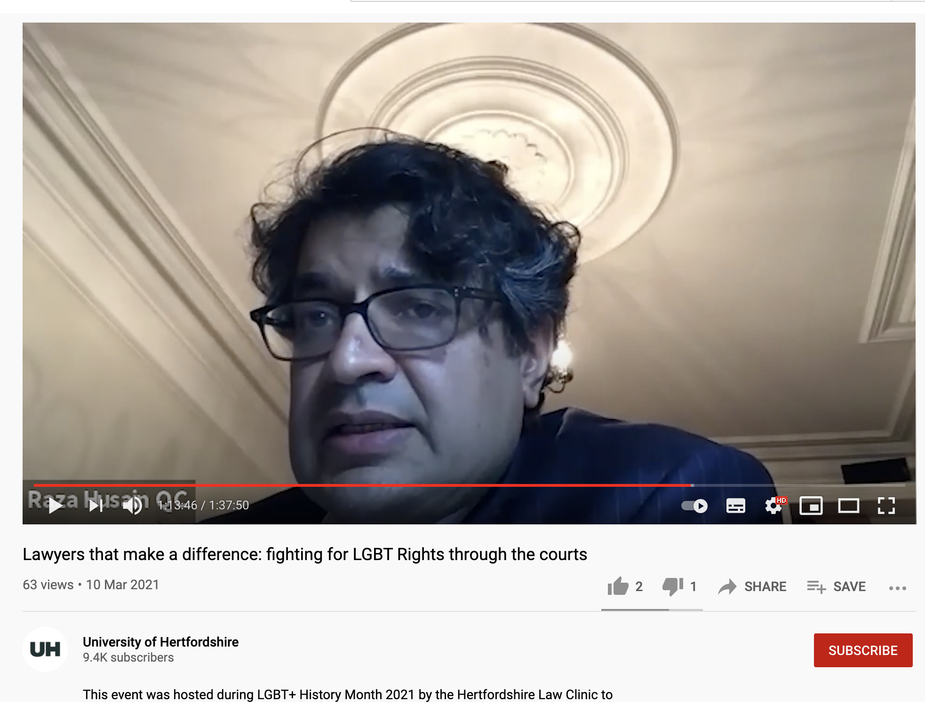
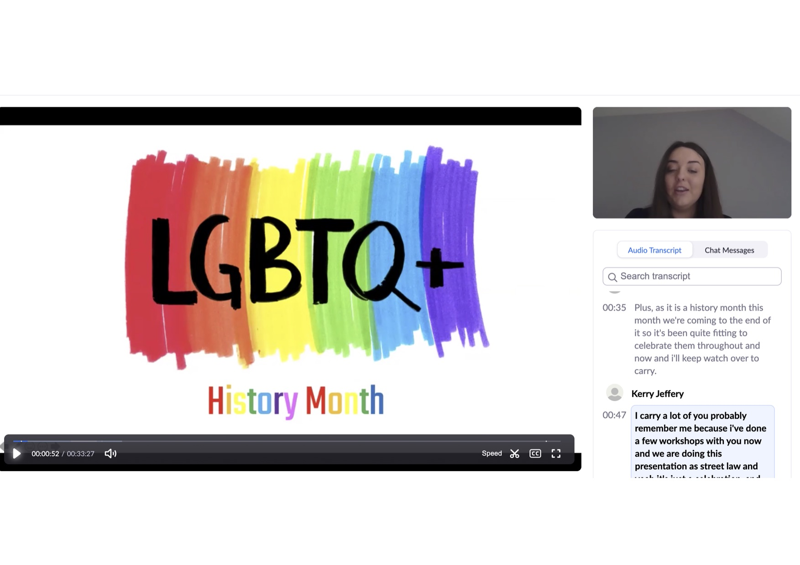
Other pro bono offshoots
Streetlaw
LGBT+ History month
Pride
Notes:
So as we said at the outset – we have as yet had no clients to our new clinic. However, the preparation and training in setting it up has provided us with other ideas for projects and presentations.
Our Streetlaw project which is still continuing online has introduced some workshops on LGBT topics. Our students designed and delivered a workshop on LGBT rights as part of LGBT history month to local year 11 students. We also recently ran a session on How to Be An Ally, which was aimed in particular at providing guidance to pupils on how to be an ally to their LGBT classmates. The session included guidance on use of pronouns.
The Law Clinic also organised an event for LGBT history month called 'Lawyers that Make a Difference, Fighting for LGBT Rights through the Courts which aimed to celebrate the role that public interest lawyers have played in advancing LGBT rights – Robin Allen QC who did the NI cake case Ashers Bakers and Raza Hussain – who was involved in an Iranian asylum case.
We also have events planned for Pride in June
[and we are looking into the option of advising schools on whether they can use a different name for a child in school if their parents refuse to accept/ cooperate (to aid child’s mental health and education experience) ??]
DK to complete….

Slide 7
Lessons Learned
Start Planning early
Make use of LawWorks and Cleo contacts
Look within your own contacts
Notes:
So it hasn’t been the easiest ride, but we got there in the end
Our top tips would be:-
Start your planning early – everything takes longer than you think
Talk to others who have already done it – so thanks again to our lovely LawWorks colleagues
Look at who you already know to see if they can help – our SU students were brilliant and the Law Society assistance came through a personal friend

