Slide 1
Writing case studies
Gill Mooney
Impact Support Officer
G.S.Mooney@hud.ac.uk

Slide 2
Introduction
Background to Huddersfield Legal Advice Clinic case study
What to include in a case study
Evidence for case studies
Reflections
Getting started

Slide 3
Points to keep in mind
Be clear about the purpose of the case study
what are you trying to say?
Be clear about the audience for your case study
who are you saying it to?

Slide 4
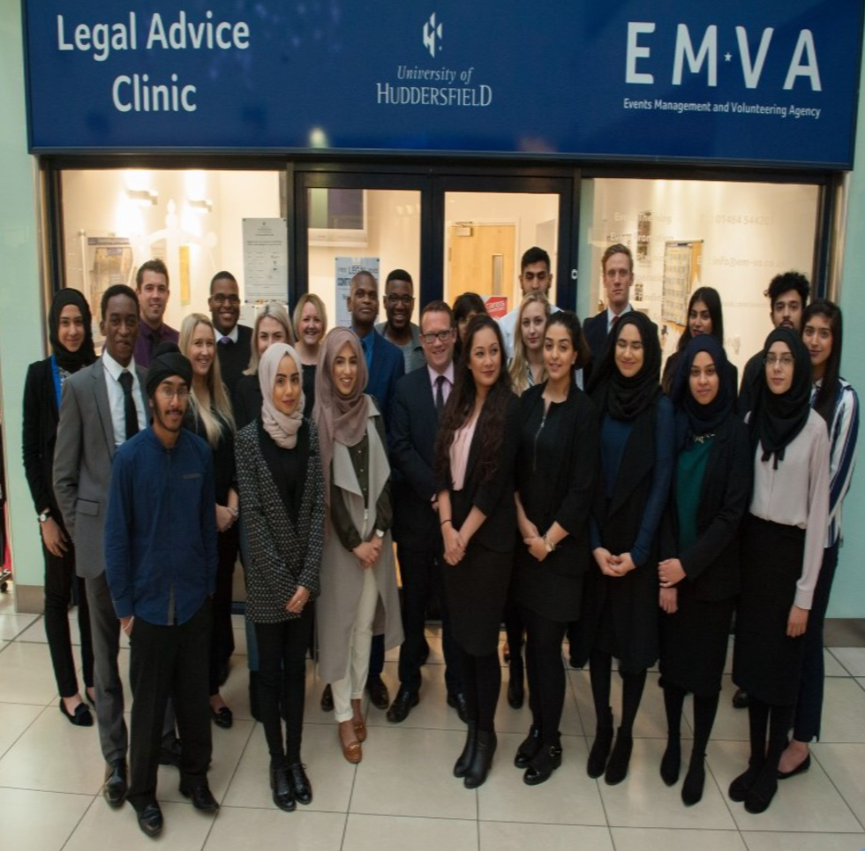
Background: Huddersfield LAC
University of Huddersfield Legal Advice Clinic
Student led
Based in central Huddersfield
Response to legal aid cuts
Issue-specific drop-ins from local solicitors

Slide 5
Background: REF2021
Research Excellence Framework 2021 (REF2021)
Demonstrate the impact of University research
Impact case studies – 25% of overall submission
Legal Advice Clinic selected for inclusion

Slide 6
REF2021 impact case studies
Relevant sections:
Details of the underpinning research
Details of the impact
Sources to corroborate the impact

Slide 7
Identifying impact
Beneficiaries
Who has felt the impact of the work?
How?
Stakeholders
Who is involved in your work?
Who has an interest in your work?
Be clear – who are these individuals/groups and how have they been involved/affected?

Slide 8
Evidence for case studies
UoH case study:
Statistics from the Clinic
Feedback from clients
Testimonials from specific clients
Testimonials from former student advisors
Testimonials from solicitors
Testimonial from LawWorks

Slide 9
Types of evidence
Testimonials | Intellectual property records | Policy Documents
Project reports | Funding evidence | Sales records
Accounts | Quantitative reports | Evaluation reports
Awards | Market data | Social media engagement

Slide 10
Gathering evidence
Inconsistent data gathering
Contacting former clients
Contacting former students
Asking for help with evidence

Slide 11
Getting started
Think about beneficiaries and stakeholders
Maintaining these relationships are key
Think about how you can gather evidence
Ongoing statistics collection
Feedback from clients
Feedback/testimonials from other stakeholders

Slide 12
Any questions?
Gill Mooney
Impact Support Officer
G.S.Mooney@hud.ac.uk

