Slide 1
Comprehensive Spending Review (CSR)
Legal and Advice Sector Roundtable

Slide 2
Cross sector challenge
Target your case
Business case for investment in advice
Use your data
Management information, client records, case studies
Value your outcomes
Monetize the difference your service makes,

Slide 3
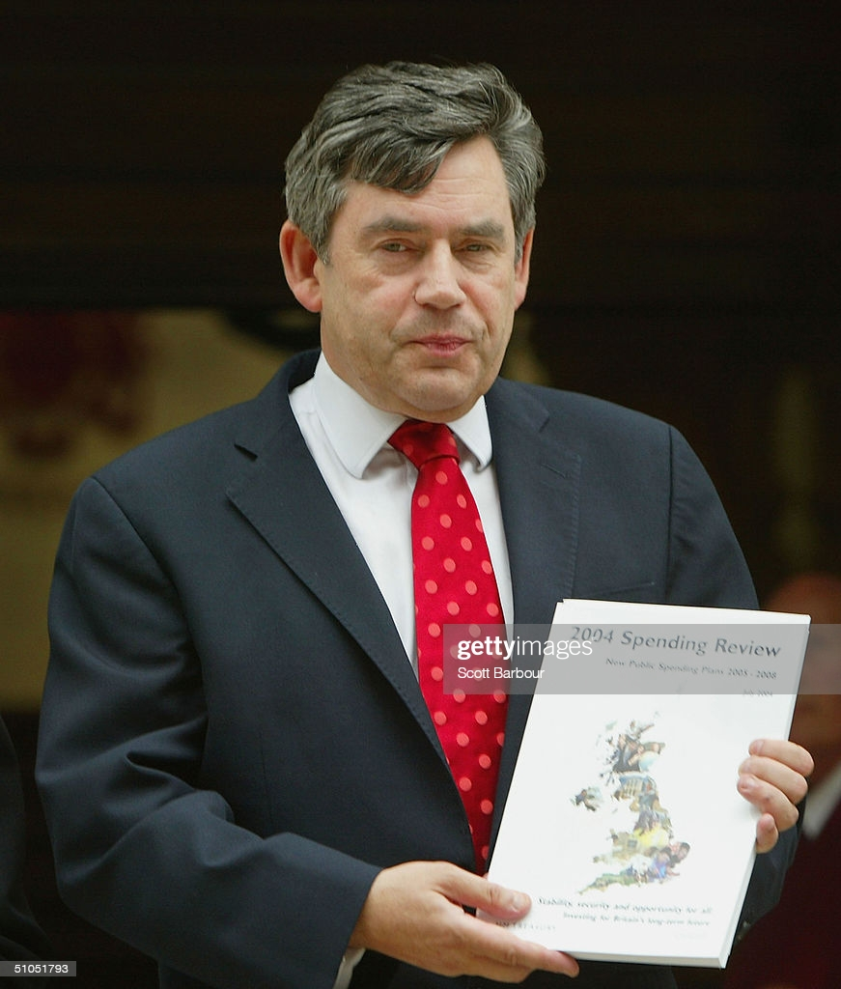
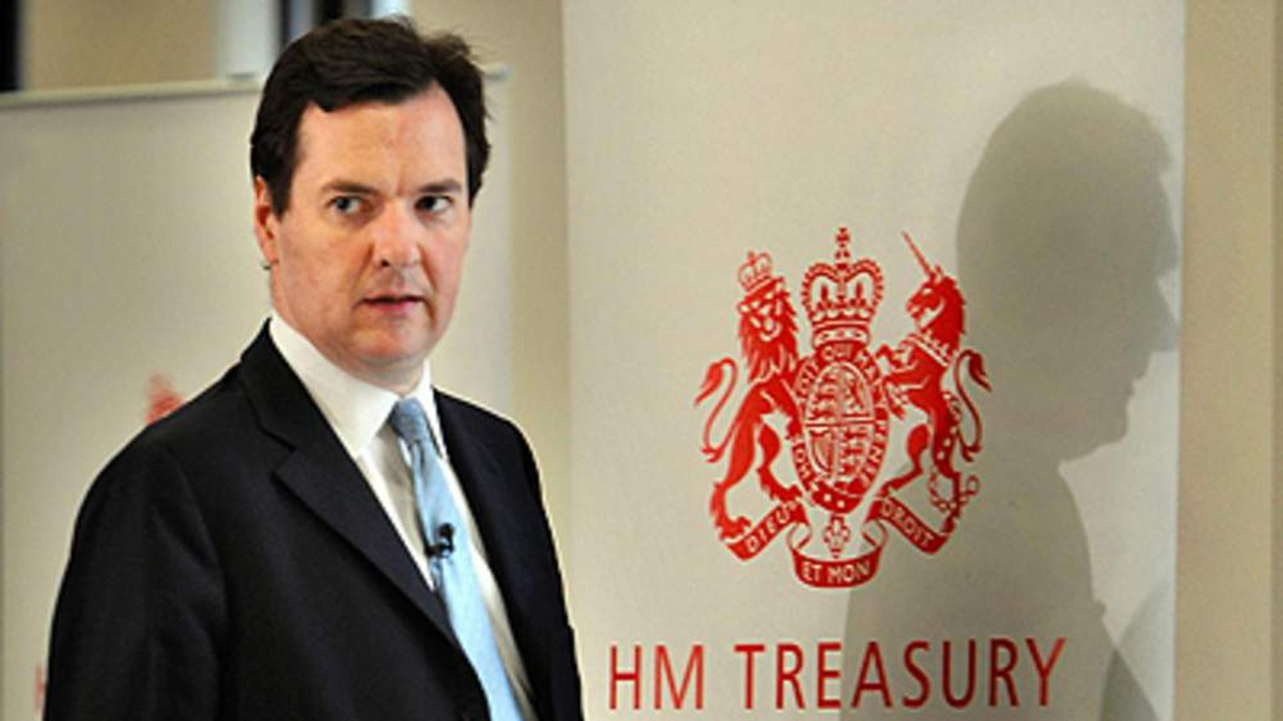
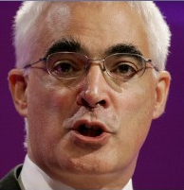
History of CSR

Slide 4
CSR – the basics
Set Departmental Expenditure Limits (DEL) – and devolved settlements - for 3 years in advance – “Multi-year” review cycle
Spending Reviews have no legal status and do not set actual budgets, these are enacted on an annual basis through the usual Budget process is every March
Negotiations and discussions take over several months between departments, HM Treasury and ministers

Slide 5
CSR – 19/20/21
Brexit (2019): Full “multi-year review” would be postponed until 2020, with an “accelerated exercise” to set limits for day-to-day spending in 2020/21; the 2019 spending round pledged higher public services spend rising by 10.7% 2019–2024
Covid: In 2020 the government opted for a 1-year Spending Review because of the scale of the COVID-19 pandemic and its unknown impact on future public finances. A key change in 2020 was to align the Spending Review to 4 focused objectives.
Levelling up, prioritizing productivity, jobs and skills
Strengthening the UK’s place in the world
Improving public service outcomes
reach net zero carbon emissions by 2050, with investment in high tech/low carbon sectors

Slide 6
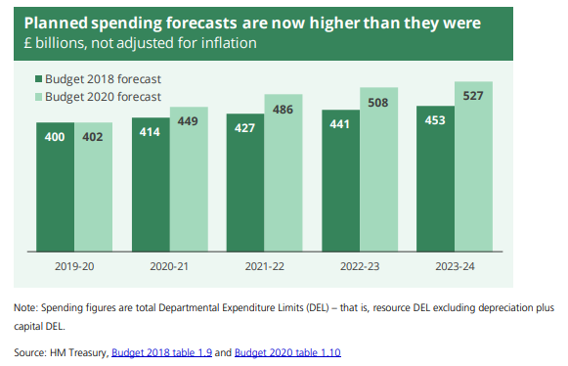
CSR – the envelope

Slide 7
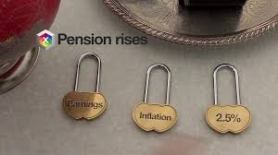
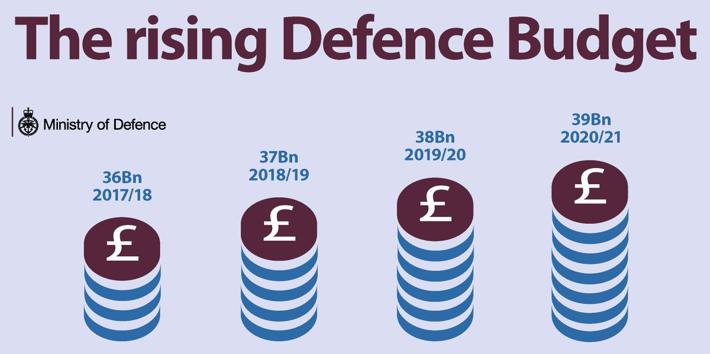
CSR – protected spend
NHS Funding Act 2020

Slide 8
CSR – challenges
Local Government: The IFS has estimated that by 2023/24, councils face cost pressures of nearly £9 billion by 2023/24 in comparison to 2019/20, with a potential funding gap of £5.3 billion even if council tax increases by 2 per cent each year and grants increase in line with inflation
Social Care: Before the pandemic showed that adult social care costs were projected to increase by £1.3 billion each year from 2019/20 to 2024/25 simply to maintain 2019/20 levels of access and quality; IFS model that councils need an extra £3.2 billion in real terms in 2024–25 to maintain services at their 2019–20 level
Health: Long before Covid-19, the government committed to increasing the NHS revenue budget by £34 billion by 2023/24.
Brexit costs: EU divorce and subsidies
Economy recovery: Focus on science, tech innovation & infrastructure:

Slide 9
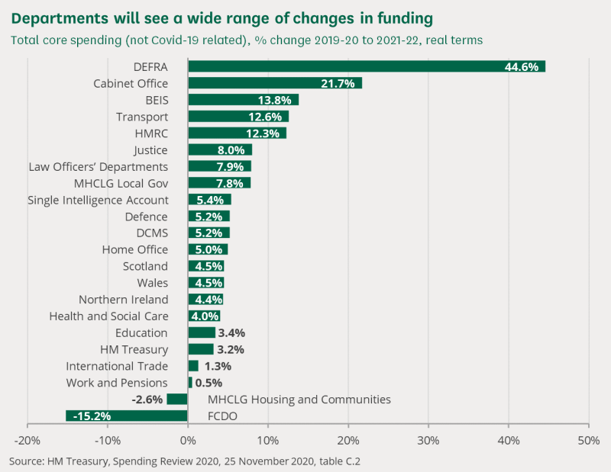
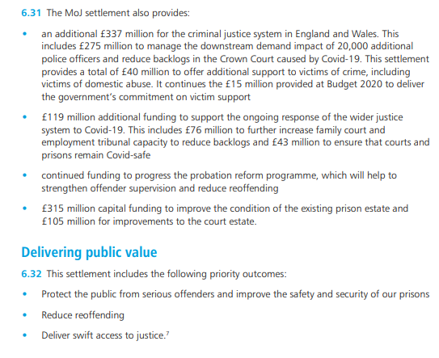
Process of CSR
Departments will agree their own “outcomes” with HMT
Submission process to HMT

Slide 10
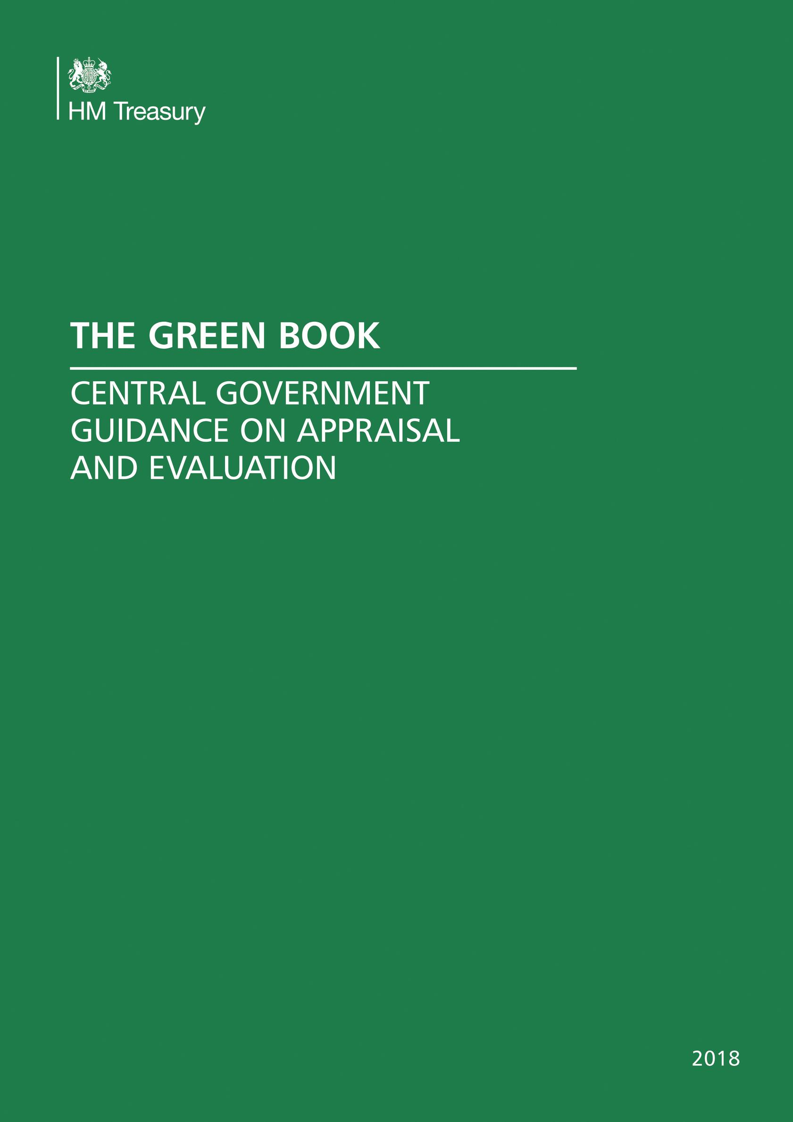
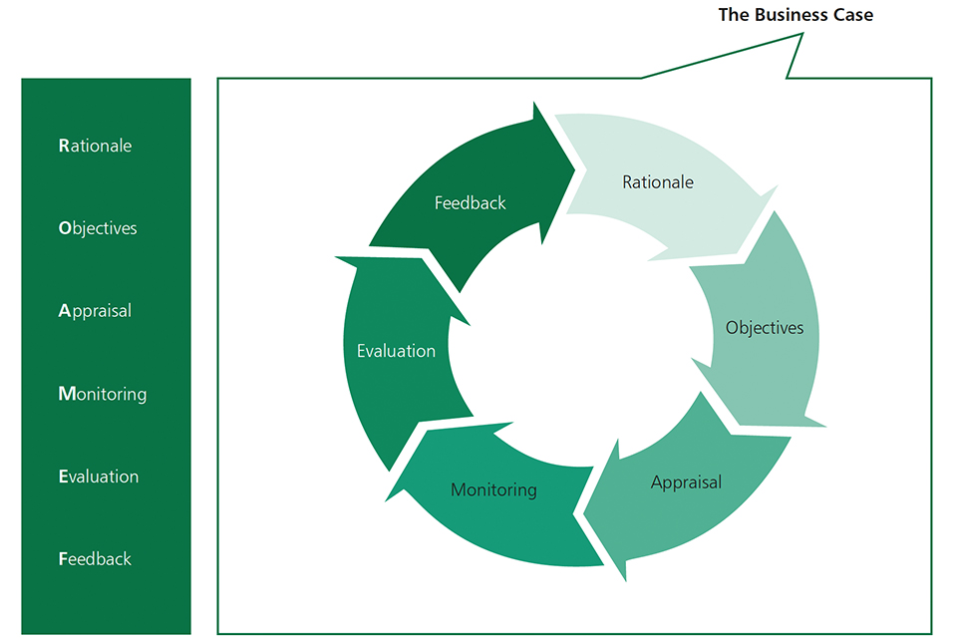
HMT GREEN BOOK

Slide 11
WHAT IS THE GREEN BOOK
Applies to making a business case in Government to for any & all policies, programmes, projects, interventions and proposals involving public spending
Impact Assessments methodologies
ROAMEF framework evidence-based policy
Economic appraisals and evaluation
Balance of (i) why (ii) public benefit (iii) risk (iv) strategic options (iv) distributional analysis (v) demand/supply (vi) procurement (vii) value for money (viii) cost/benefit (ix) counterfactual ‘but for’ (x) outcomes
BCR ratio of the value of benefits to the value of costs

Slide 12
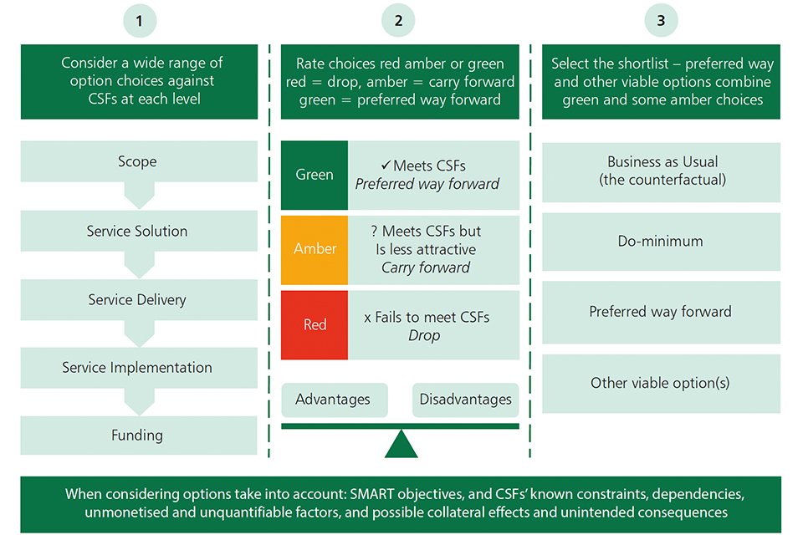
HMT GREEN BOOK

Slide 13
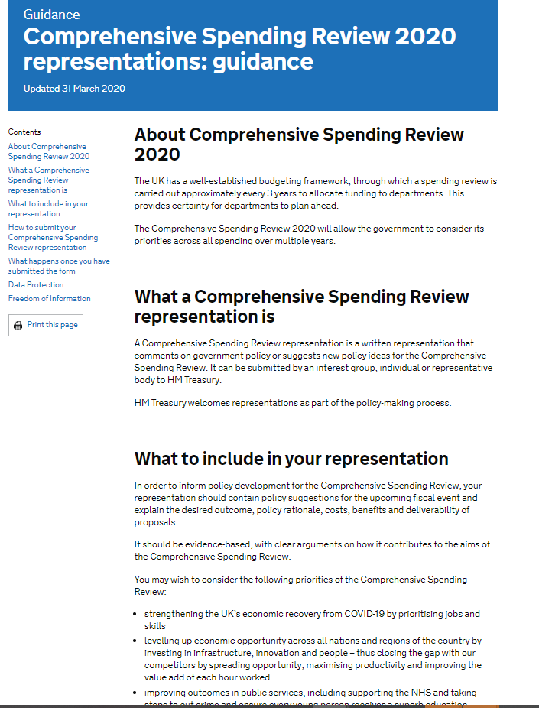
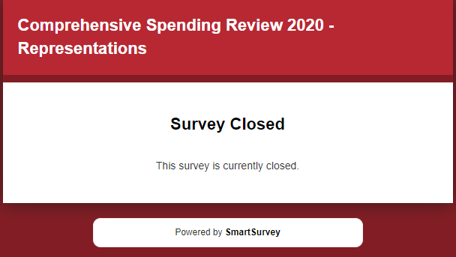
Consultation & CSR
Consultation process may vary

Slide 14
Advice Services and the CSR
Cost-benefit of advice services and interventions
How do advice services add social value and or save publics services money (eg court service, local government etc.)
Social return on investment
Sources and resources
Low Commission: The Role of Advice Services in Health Outcomes
Cookson: The business case for social welfare advice services - An evidence review
Citizens Advice: Business case for Legal Aid
Centre for Mental Health: Welfare advice for people who use mental health services: Developing the business case

Slide 15
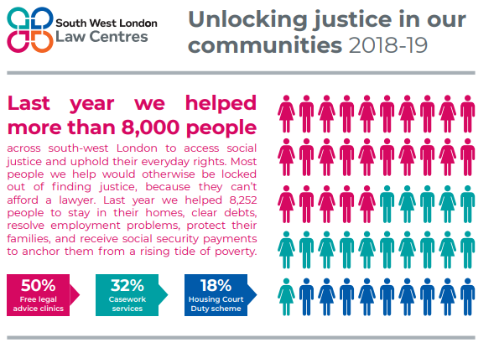
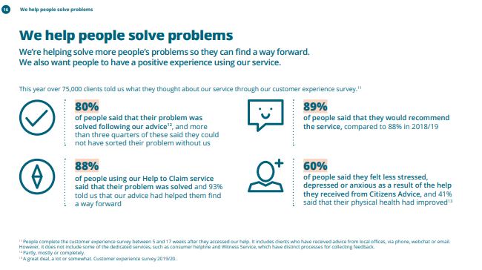
Use impact data
.

Slide 16
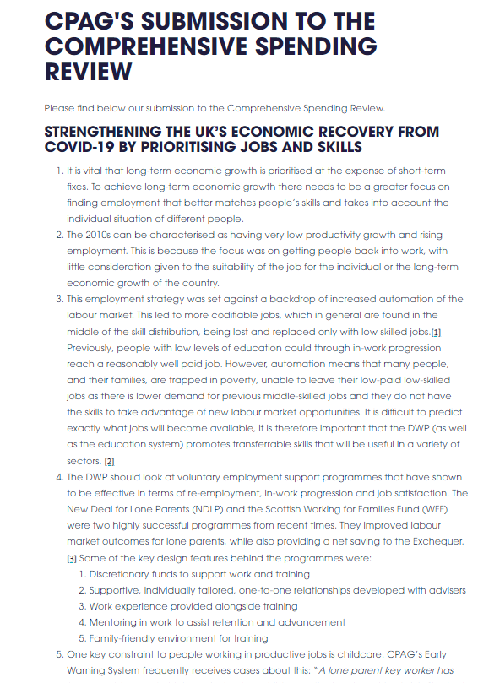
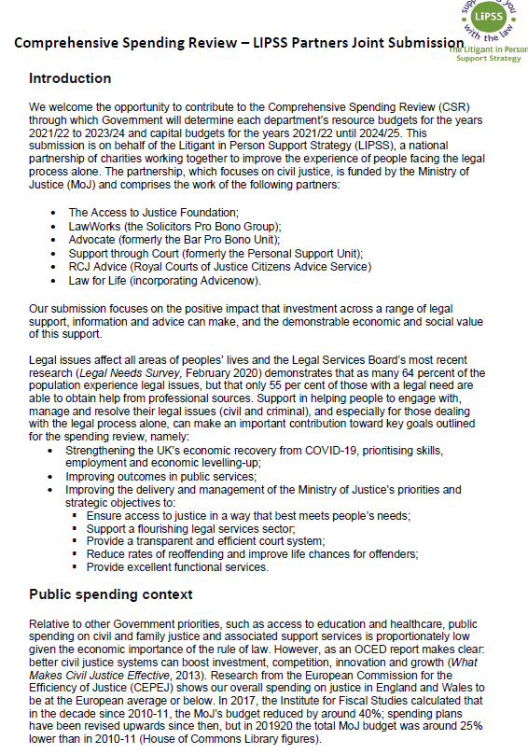
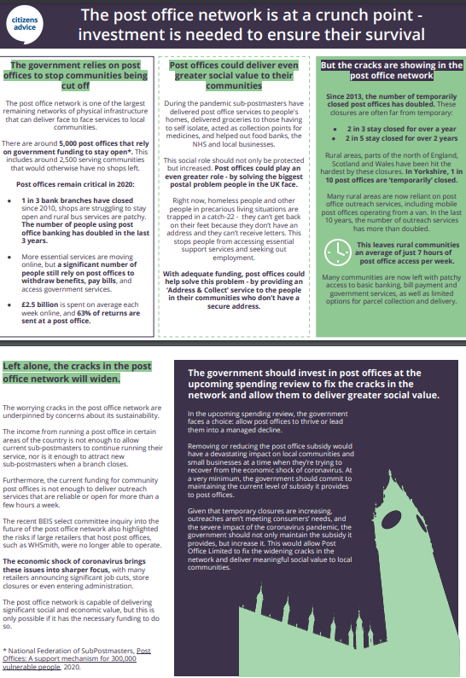
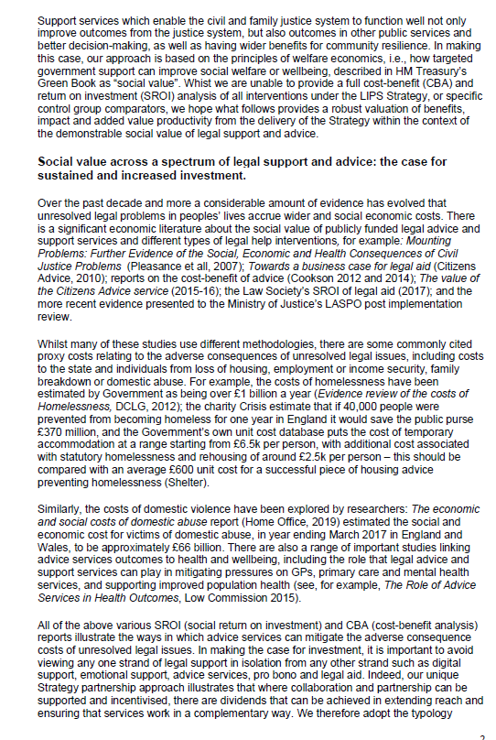
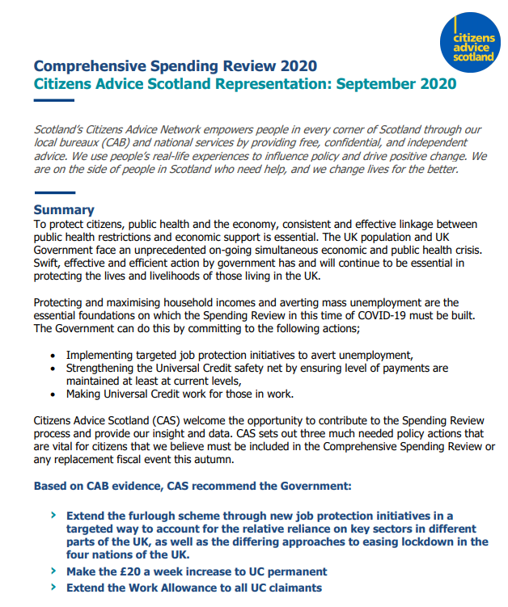
Submissions to CSR
Cost/benefit
Social value
Business case
Outcomes

Slide 17
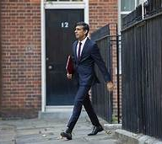
Equity for Justice
“the measure of the Chancellor’s foot”

